Slide 1




Solving the Puzzle; A MATLAB Approach to Image Reconstruction
Page 1
Presented By:
Mustafid Bin Mostafa (141)
Monem Shahariar (147)
Khondaker Muntaseer Shams (137)
Bakibullah Sakib (149)
Modou Kabirr Faal (151)
Your paragraph text

Slide 2


Problem Statement
Page 2
What is the Problem?
Given a noisy image, the goal is to reconstruct it from the pieces using image processing techniques.
Objective:
Loading the input image, denoise and convert into grayscale.
Cropping and segmenting the image into puzzle-like pieces.
Matching the best puzzle pieces to their correct locations.
Reconstructing the final image.

Slide 3

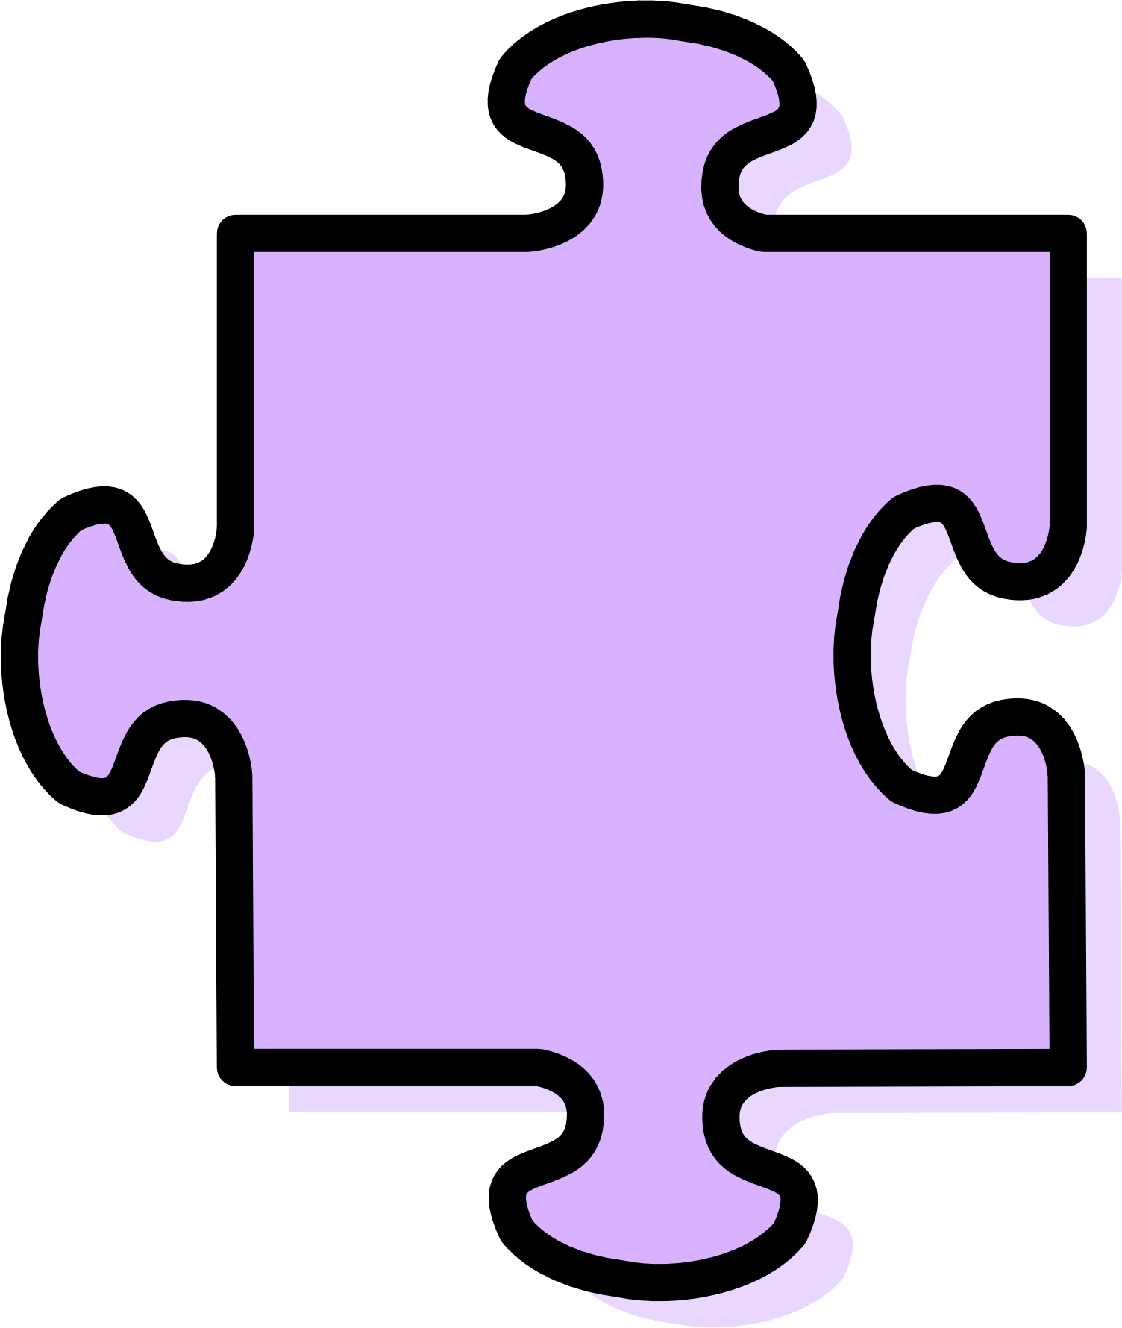
Page 3
Steps in solving the puzzle:
1
2
3
4
Load and Preprocess Images
Divide the pic into Grid Segmeent
Find Best-Matching Pieces
Reconstruct the Final Image
Arrange and assemble the matched pieces.
Display the final reconstructed image.
Compare puzzle pieces using MSE
Store the best match in a cell array for reconstruction.
Read the noisy image, denoise &
Convert to grayscale.
Split the original image into 4×4 blocks and make sure each block is within the range of the gridsize .

Slide 4
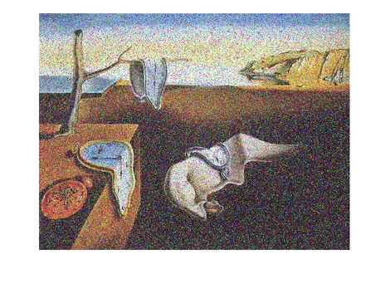
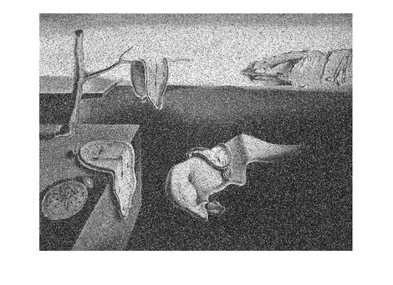
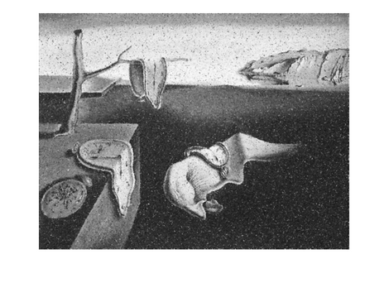
Image Preprocessing
Page 4
Load & Display Original Image:
Read image with imread
Display using imshow
RGB to Gray
rgb2gray(originalImage)
Denoising:
Median filter is used to remove noise.
Function : medfilt2( )
Your paragraph text
Your paragraph text
Your paragraph text
Your paragraph text
Your paragraph text
Your paragraph text

Slide 5
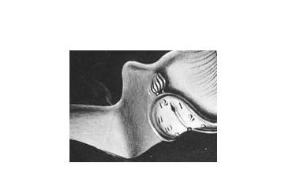
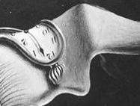
Page 5
Cropping Images
Puzzle Pieces Read
Reads all 16 images using imread and sprintf.
Original image
Threshold Set to 225
Converts each image to grayscale and applies a mask to identify non-white areas (pixels < 225).
Masking and Cropping
Extracts image regions without white borders and saves the cropped images using imwrite.
Cropped Image

Slide 6
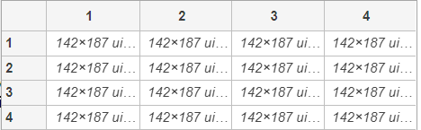
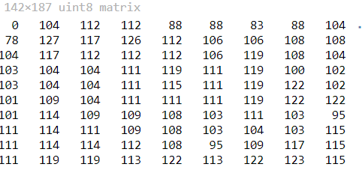
2
Page 6
Grid Division
Finding the individual number of rows and columns in each block.
Split the original image into 16 4x4 blocks and ensure each block stay within bounds specified earlier.

Slide 7

Page 7
Matching Puzzle Pieces
Initialize a matrix to store the final arrangement of puzzle pieces and an array to keep track of used puzzle pieces
Load each puzzle piece and store it in an array
Loop through each block of the original image and find the best matching puzzle piece using MSE

Slide 8
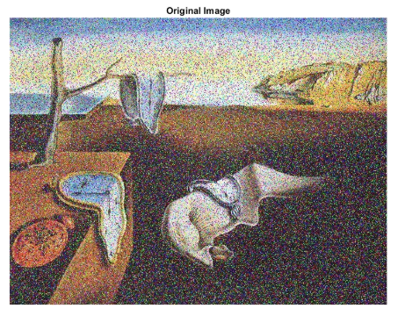
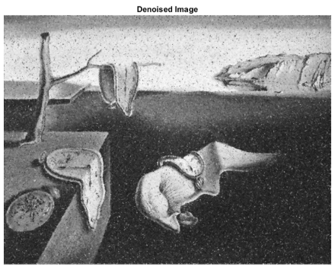
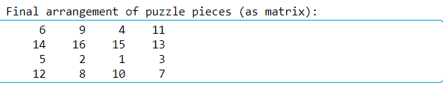
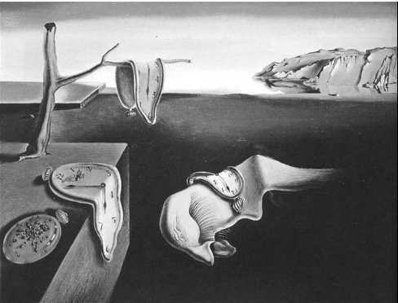
Page 8
Reconstruction
After matching, assign the best matching piece to the current position and form the spatial matrix
Original Image
Denoised
Initialize the reconstructed image as grayscale, resize and place
Reconstructed Image

Slide 9

Results & Challenges
Page 9
Results
Challenges
✅Successfully reconstructed the image using grid segmentation and MSE-based matching
✅Effective image pre-processing (grayscale conversion, thresholding and mediane filtering).
✅Puzzle pieces correctly matched and arranged.
Resizing of puzzle pieces led to minor loss of details
No need to rotate any image as imread loads the image with original orientation

Slide 10
Page 10
THANK YOU

